Slide 1

Middle School Alcohol Abuse & Demographics
By: Taylor Corbalis, Courtney Sutton, and Johnny Whitaker
Notes:
taylor

Slide 2
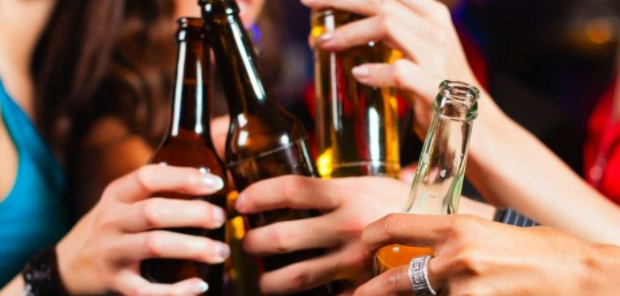
The Problem: Middle School Alcohol Abuse in the U.S.
Effects on students ages 11-13
Can decrease motivation in school
Can create health problems
Notes:
taylor

Slide 3
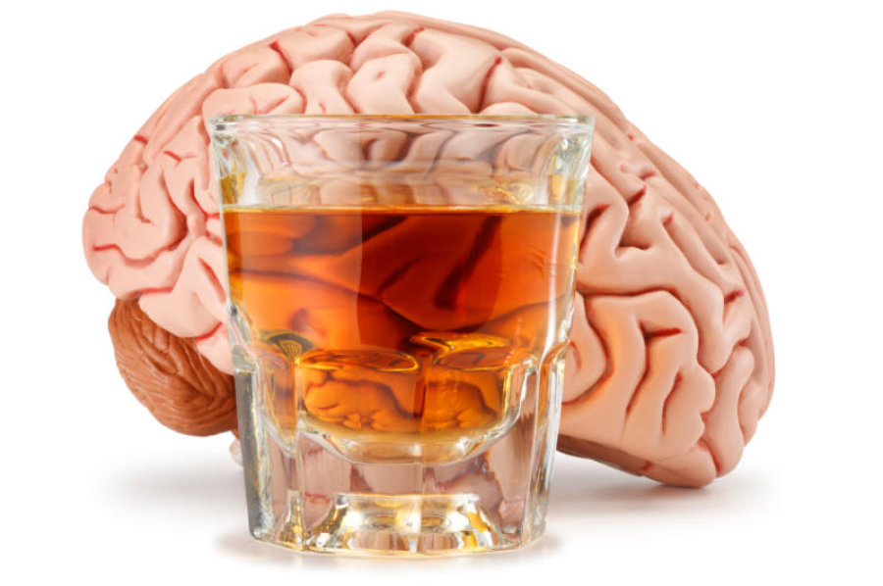
Obtaining Data & Project Goals
Publicly shared data from CDC:
Location
Sample Size
Gender
Ethnicity
Grade
Strat Type
High Risk Proportion
Goal: To measure the correlation between demographics of middle schoolers to risk factor of alcohol use
Notes:
taylor

Slide 4

Business Problem
The results of this study are important for two economical reasons:
Direct impact on workforce
More dropouts decrease the qualified pool of applicants
Lower college enrollment
Allocation of resources
Amount of financial and infrastructural capital on government budget
Under-utilization of resources cost civic benefits
Notes:
taylor

Slide 5

Data Cleaning Steps
Initial data: >33,000 entries
Data is split into greater risk and lesser risk proportions
Further divided by confidence limit
Limited to at least 100 respondents
Only statewide
Only single demographic respondents kept
Notes:
taylor

Slide 6
Data Cleaning Steps
Converted to string and encoded:
State
Gender
Ethnicity
Grade
Stratification Type
Notes:
taylor

Slide 7
Data Cleaning Steps
After Cleaning: 1,511 entries
Changed the target variable
Initial idea to measure against graduation dates
Notes:
Taylor
Originally had target variable as graduation rates, not good to measure predictive analytics w the confidence levels bc measuring same demographic twice, instead Isolate single proportion and use that as target variable

Slide 8
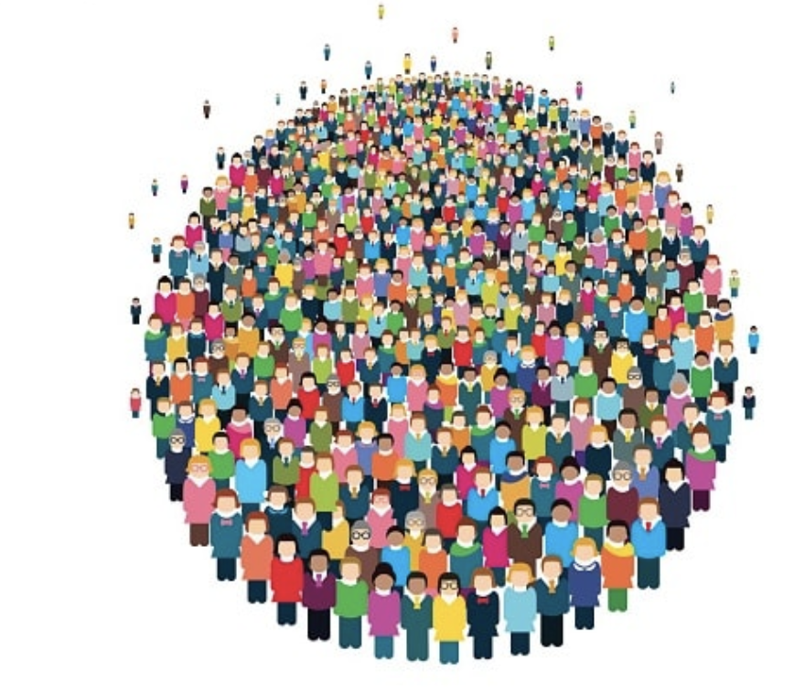
Variables - Cleaned
Categorical
Year
State
Sample Size
Gender
Ethnicity
Grade
Strat Type
Target Variable
High Risk Proportion
Notes:
Taylor
Stratification type- left as just states, thought this would be initially important, results overall commenting nationally rather than commenting on state

Slide 9
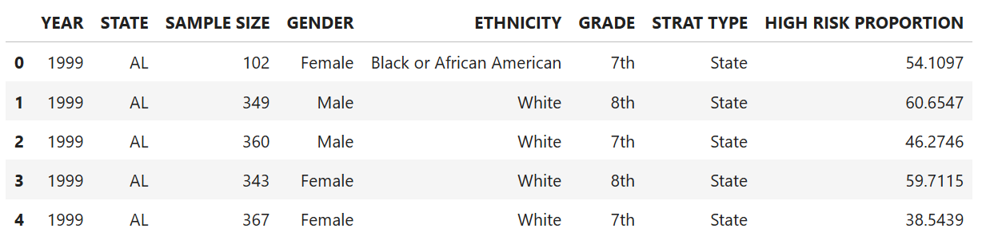
Variables - Cleaned
Notes:
Taylor
This is our header with all of the variables that we used

Slide 10
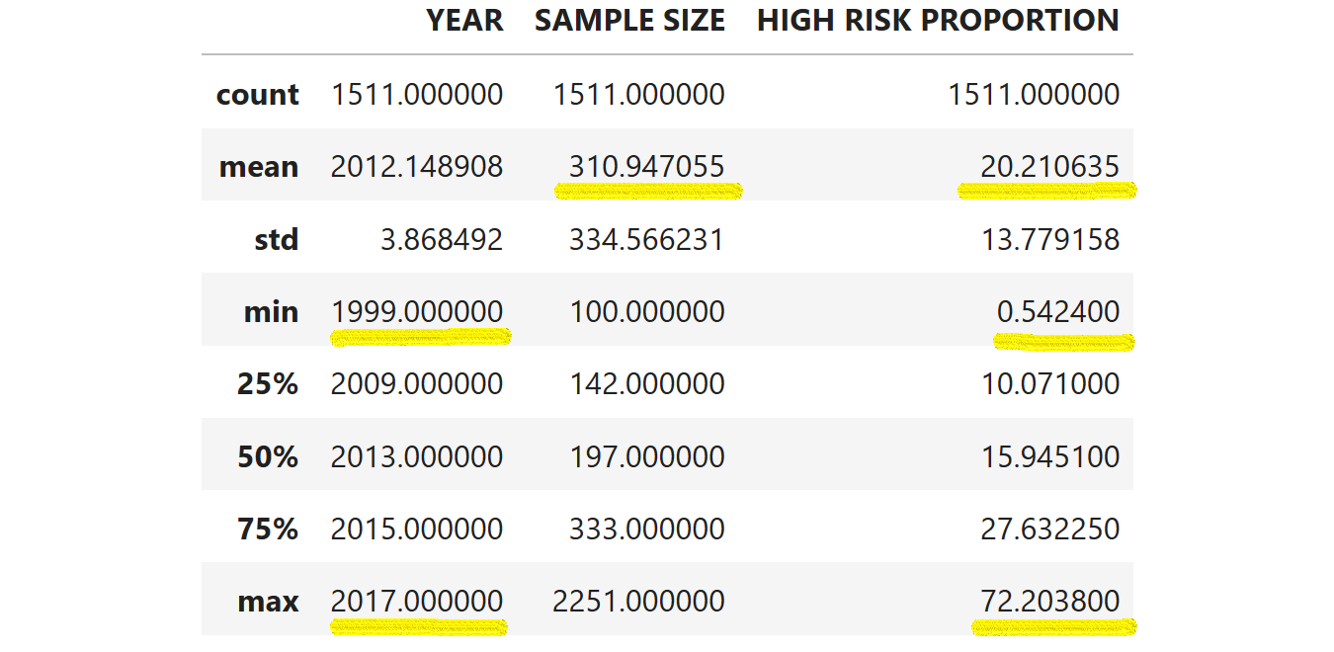
Descriptive Analytics

Slide 11
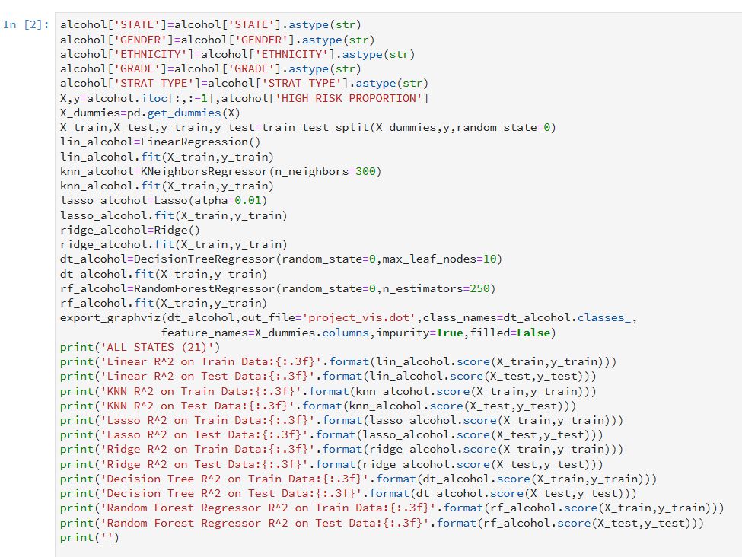
Predictive Analytics
21 States
Linear Regression
KNN Regressor
Lasso Regression
Ridge Regression
Decision Tree
Random Forest
132 Models

Slide 12
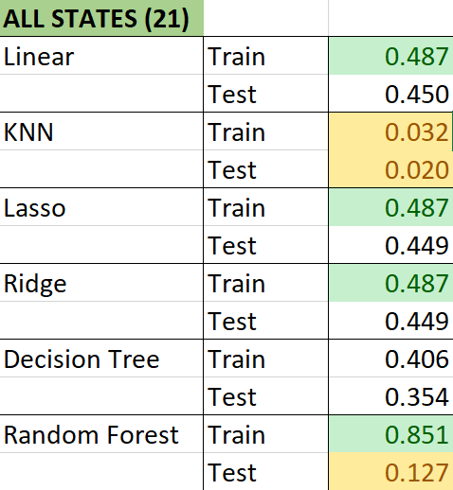
Predictive Analytics

Slide 13
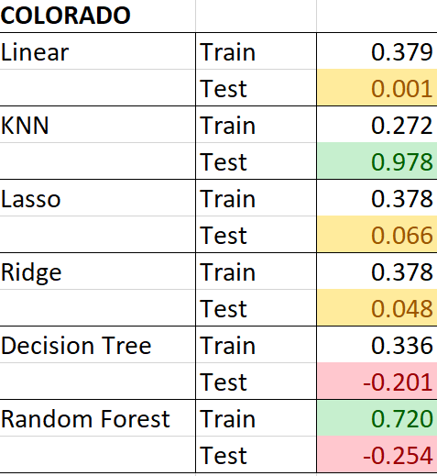
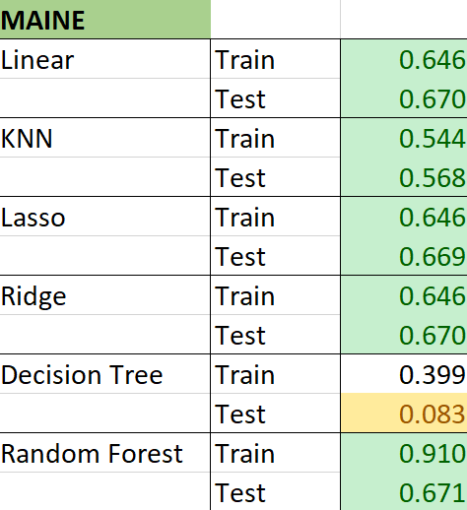
Predictive Analytics

Slide 14
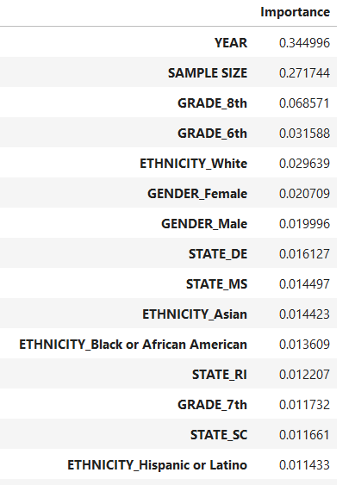
Predictive Analytics

Slide 15
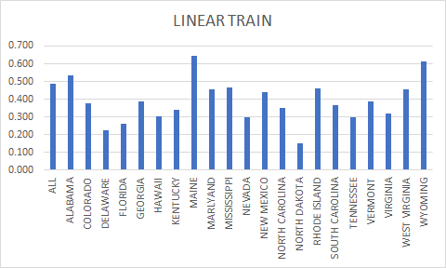
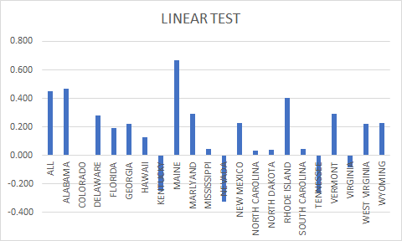
Linear Regression R²

Slide 16
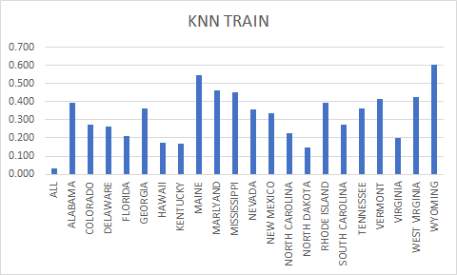
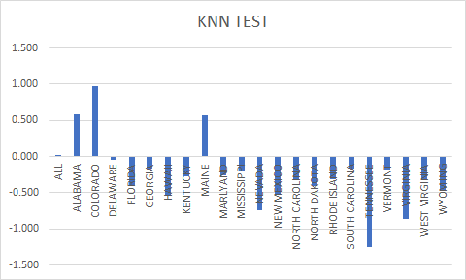
KNN Regressor R²

Slide 17
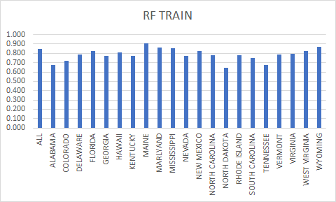
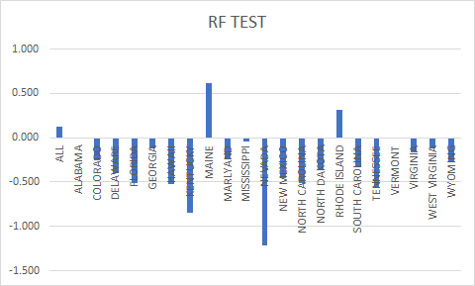
Random Forest Regressor R²

Slide 18
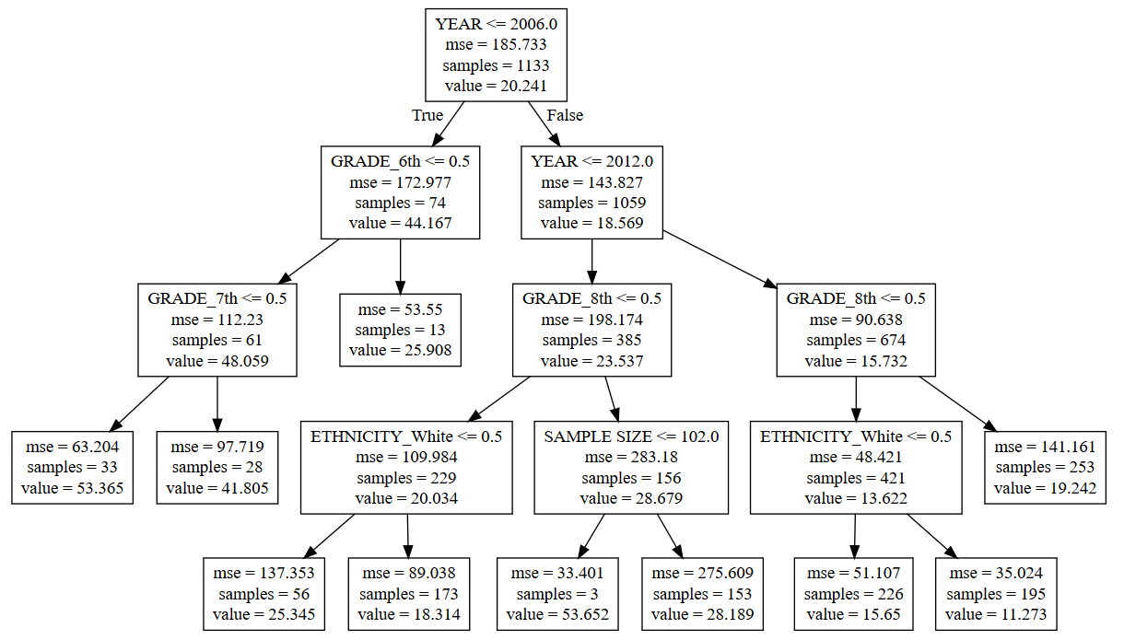
Decision tree
(all states)
Notes:
Here is the decision tree for all of the states. With a max leaf nodes of 10

Slide 19

Predictive Analytics
Student Group 1
Surveyed in 1999 and 2007
Sample size: 420
Tennessee
Female
Hispanic or Latino
7th grade
Strat type: state
Student Group 1A (1999)
Greater Risk Proportion: 41.92%
Student Group 1B (2007)
Greater Risk Proportion: 34.03%
Notes:
For our predictive analytics we chose 3 sub groups. Each group was tested in two different years. The first group…. We observed a decrease in risk proportion of time

Slide 20
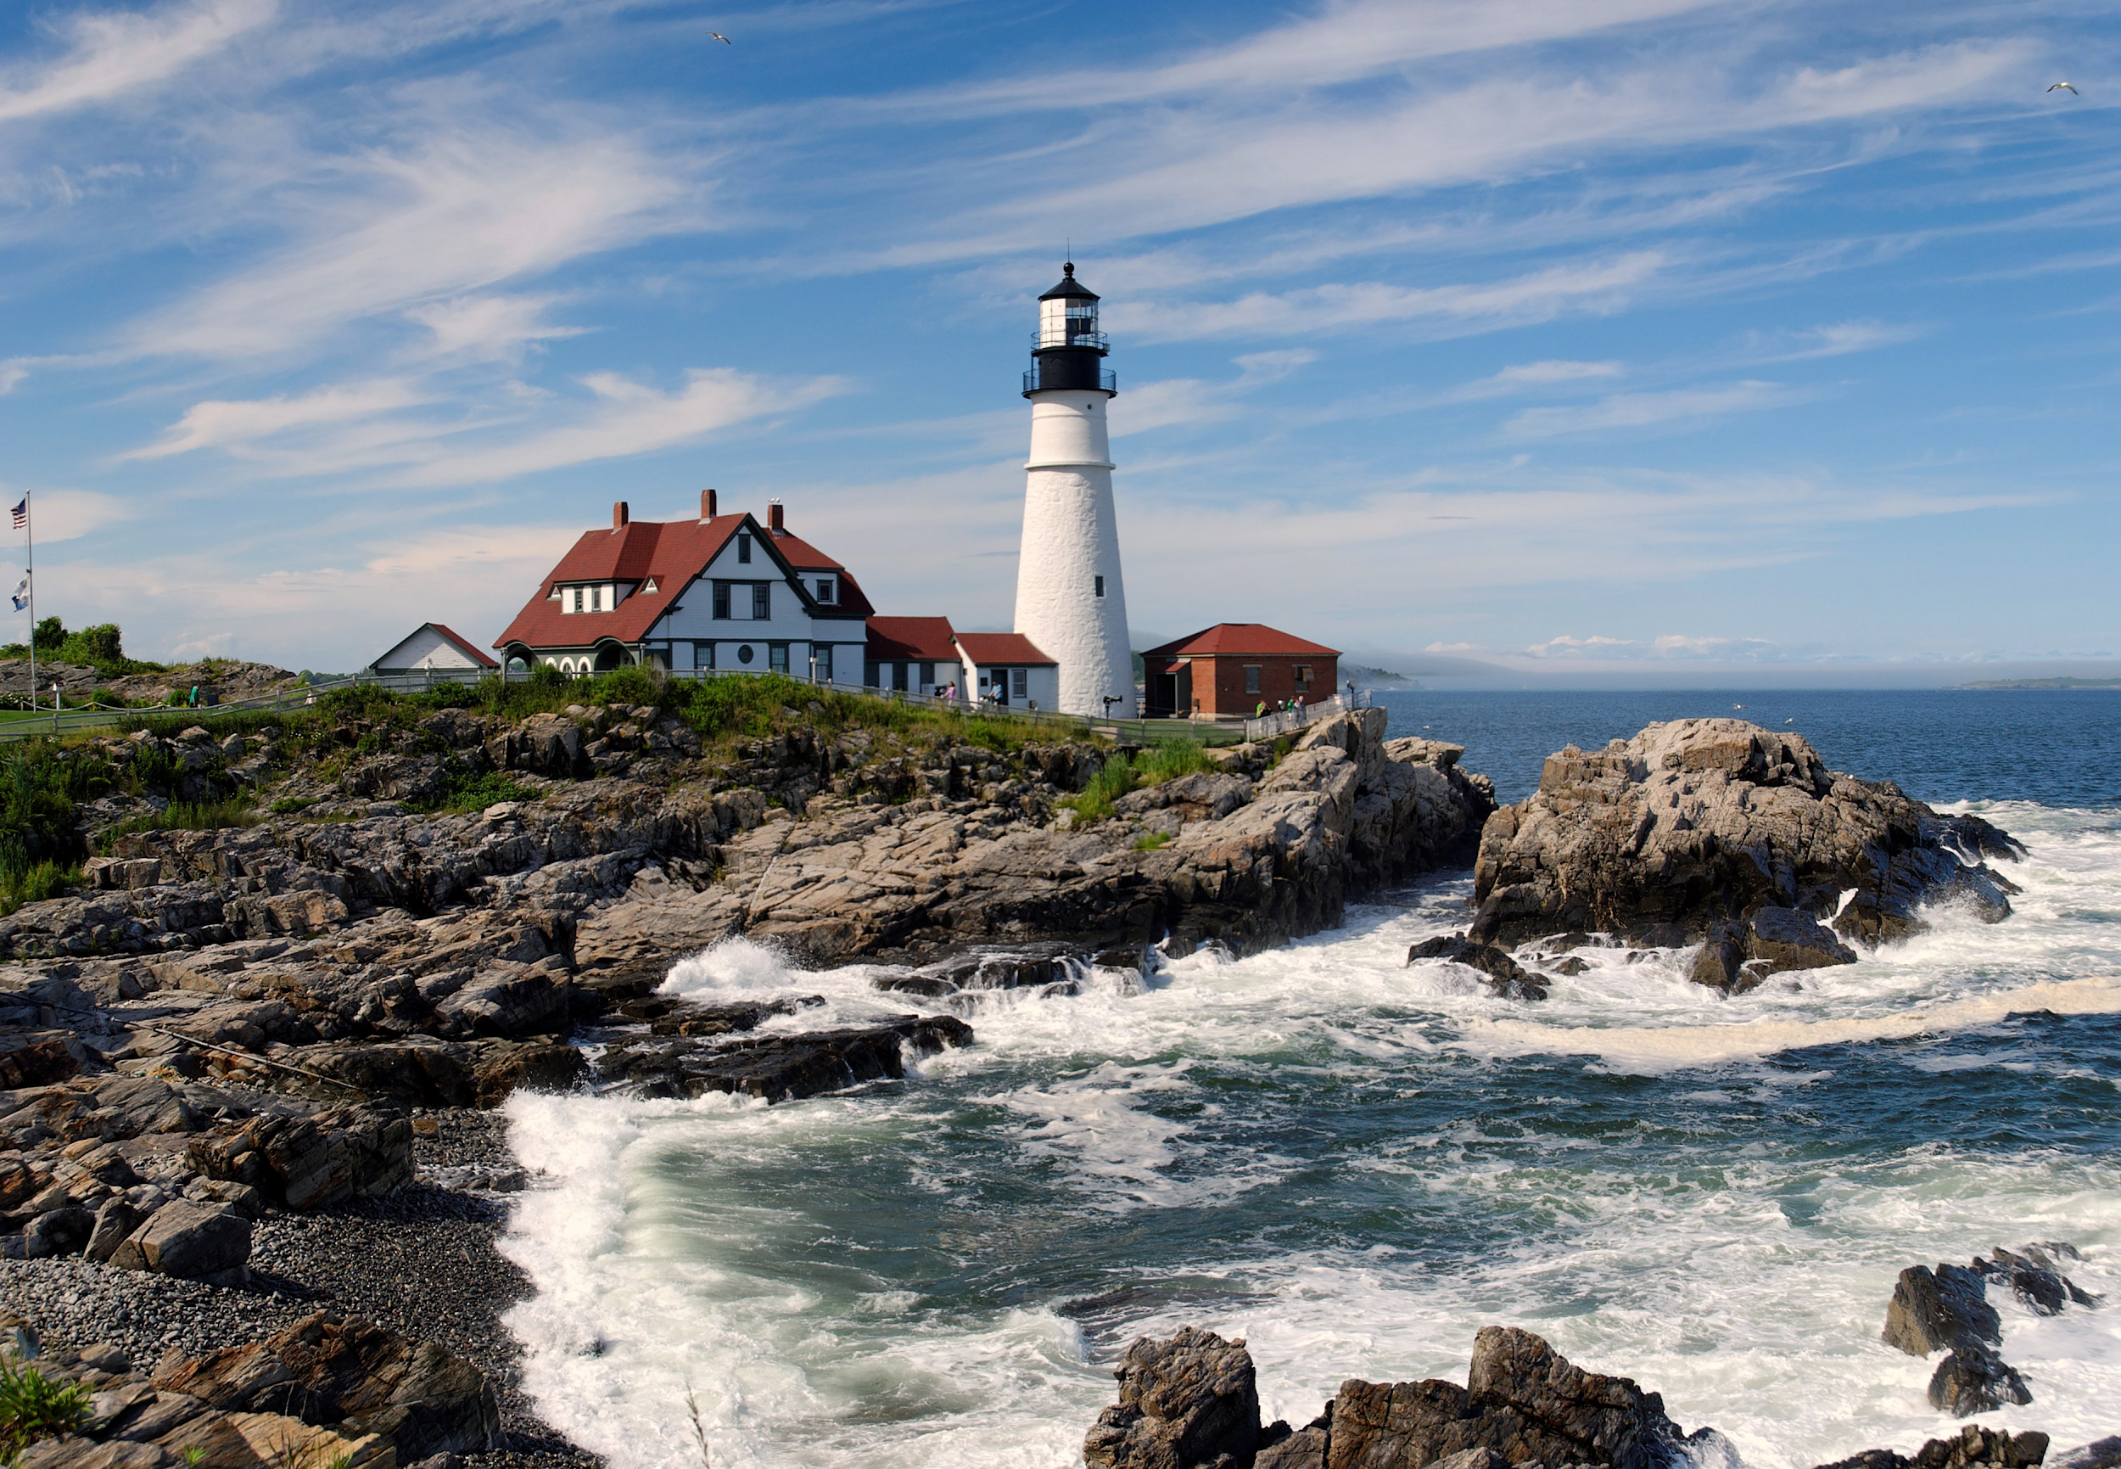
Predictive Analytics
Student Group 2
Surveyed in 1999 and 2007
Sample size: 150
Maine
Male
White
6th grade
Strat type: state
Student Group 2A (1999)
Greater Risk Proportion: 43.45%
Student Group 2B (2007)
Greater Risk Proportion: 43.45%

Slide 21
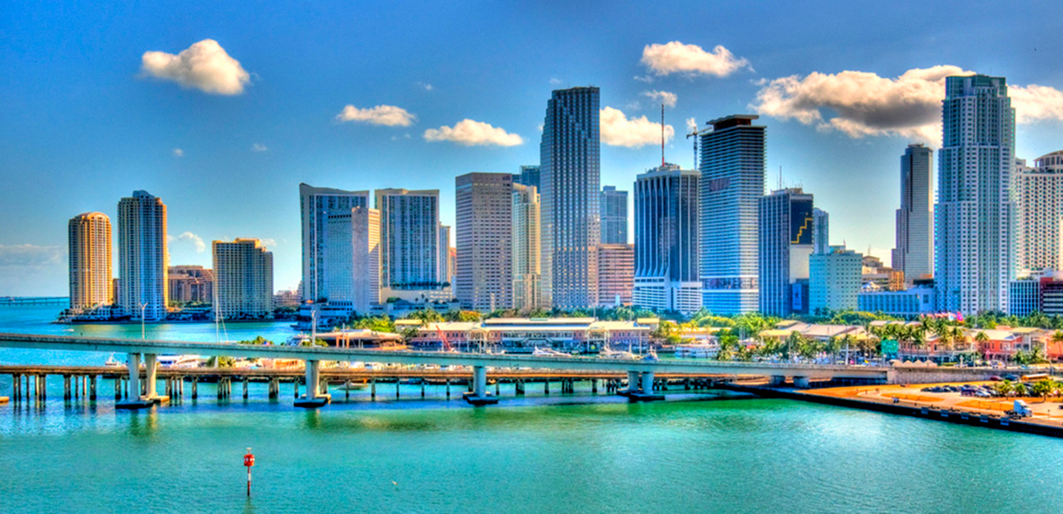
Predictive Analytics
Student Group 3
Surveyed in 1999 and 2007
Sample size: 640
Florida
Male
Black or African-American
8th grade
Strat type: state
Student Group 3A (1999)
Greater Risk Proportion: 59.51%
Student Group 3B (2007)
Greater Risk Proportion: 31.50%

Slide 22

Conclusion
Decreasing risk of teens consuming alcohol since 1999
State of little importance
Can be applied nationally
Poor results
Greater subjective value
Notes:
We observed an overall decreasing trend for fisk of teens consuming alcohol since 1999
The state variable displayed little difference and has little importance. Because of this it can be applied nationally
We got poor results because of poor data due to greater subjective values
Good for showing results

Slide 23
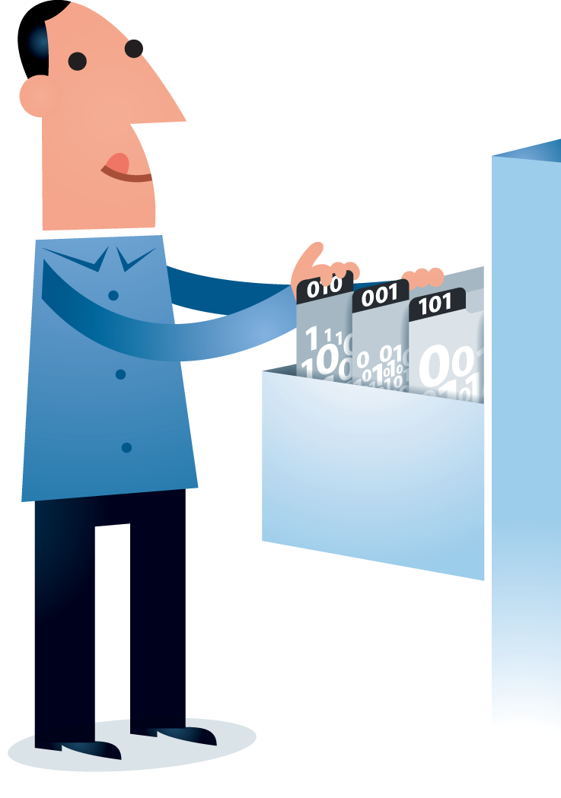
Recommendations
-
For the community
Bring awareness to trends in youth alcohol abuse
Be aware of correlations with demographics
Non-actionable results
For the CDC
Gather better data
Include more objective variables

